Slide 1
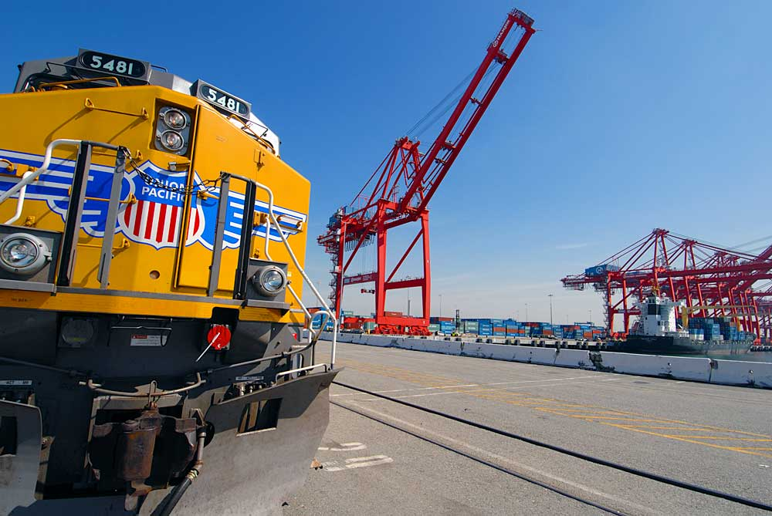
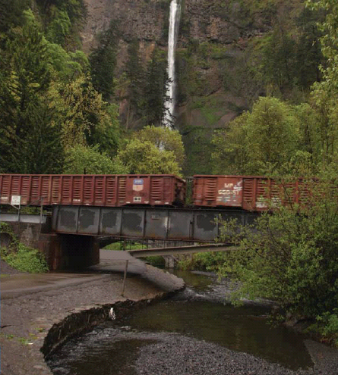
Shipping Scrap Steel with Union Pacific
September 2014

Slide 2
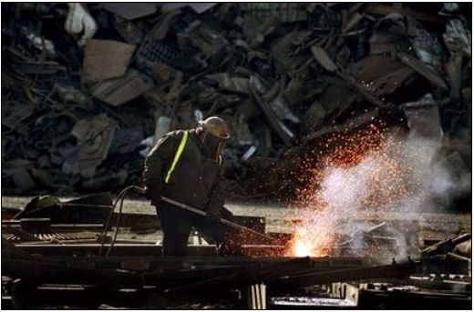
Scrap Steel & Union Pacific
Union Pacific is committed to:
Transportation Value
Customer Satisfaction
Safety
AAR loading rules were established to protect:
Customers
Railroad Employees
Personal and Public Property

Slide 3
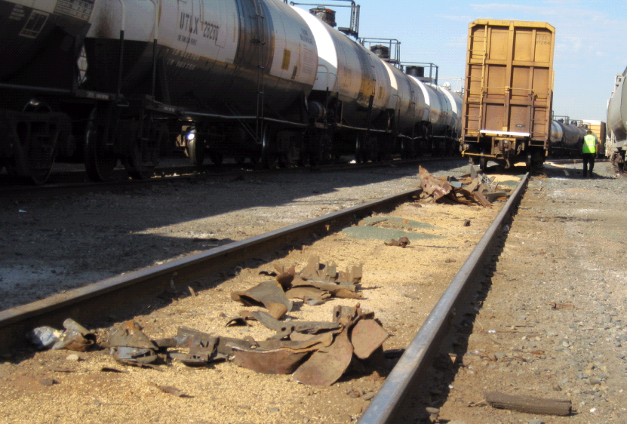
General Loading Rules for Scrap Steel
Loose Scrap
Loading must be below the top of rail car sides and ends of car at any point of the load
Baled Scrap
Must have 51% of the bale below the top of the gondola
Violations
Shipments found in violation are subject to being reworked at the customers cost

Slide 4
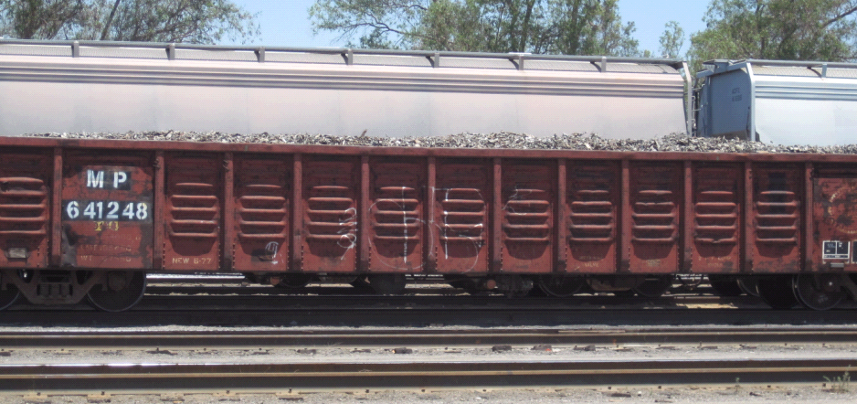
Shipping Loose Scrap in Gondolas Examples: Not Acceptable

Slide 5
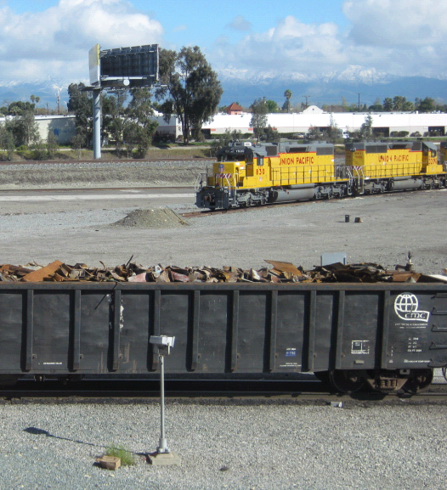
Resources
UP Shipment Quality
American Association of Railroads
http://www.uprr.com/customers/dam-prev/index.shtml
http://www.aar.com/otlr.htm

