Slide 1

UP SourceHub
Supplier
Webinar
Series
(for DWR services)

Slide 2
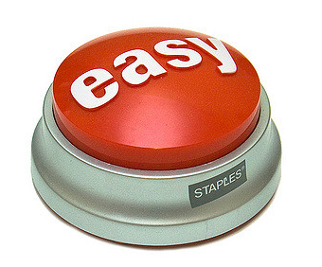
UP SourceHub
Providing a streamlined process from Procure to Pay, with complete visibility along the way
User friendly
100% electronic
Improves efficiency
Drives down cost
Facilitates compliance

Slide 3



Enhanced Procurement Workflow
Provides a streamlined process from request to pay
Requester
Approver
Supplier
(Office)
Supplier
(Field)
Verifier
Supplier
(Office)
Releaser
Submits requisition
Approves PO
Accepts PO
Performs work
and enters SES
Verifies work and SES
Submits SES
for invoicing
Approves SES and releases for payment

Slide 4

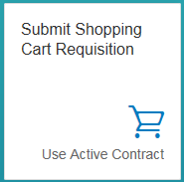
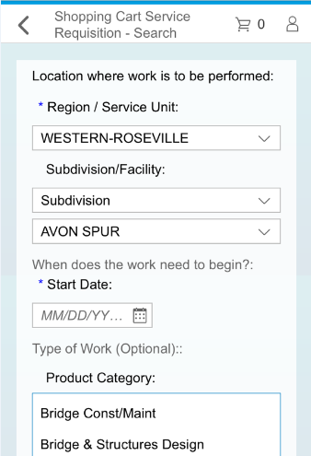
Submit Requisition
UP Requester submits requisition for service using a shopping cart model
Can request a service with existing contract or for new contract
REQUISITION
APPROVAL
PO
WORK/SES
INVC/PMT

Slide 5
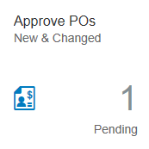

Approve PO
UP Approver reviews and approves requisition/PO electronically and PO issued to supplier
REQUISITION
APPROVAL
PO
WORK/SES
INVC/PMT

Slide 6
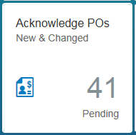

Accept PO
Supplier issued electronic with details of requisition to begin work
If PO is accepted, Supplier can begin work.
If PO is rejected, Requester is notified and Supply Chain will coordinate alternate sourcing
Supplier cannot invoice UP without an accepted PO
REQUISITION
APPROVAL
PO
WORK/SES
INVC/PMT

Slide 7
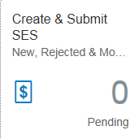

Work Performed/Invoiced
Supplier performs the work as scheduled
Supplier submits Service Entry Sheet (SES)* into UP SourceHub with work and billing details
System ensures all required information is filled in completely
UP SourceHub can be accessed by employee through the web link and a PIN that will be provided with the PO
REQUISITION
APPROVAL
PO
WORK/SES
INVC/PMT
*SES replaces paper DWR process

Slide 8
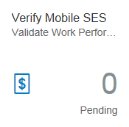

Work/SES Verified
SES routed to UP Verifier for accuracy review
UP Verifier signs off on SES using a mobile device or computer
REQUISITION
APPROVAL
PO
WORK
INVC/PMT
* Some exceptions apply

Slide 9

Submit SES for Invoicing
SES routed to Supplier (back office) for confirmation
Supplier has opportunity to review and makes any necessary changes
Supplier the submits SES as invoice for payment processing
REQUISITION
APPROVAL
PO
WORK
INVC/PMT

Slide 10
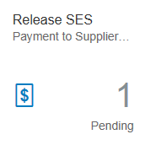
Confirm & Release SES for Payment
SES routed to UP Releaser for confirmation
UP Releaser confirms SES is accurate and releases for payment
REQUISITION
APPROVAL
PO
WORK/SES
INVC/PMT

Slide 11

Other Features & Functionality
Reporting
Bidding and Bid Management
Contracting and Contract Management
eSignatures
Supplier Profile Management

Slide 12

Technical Specifications
REQUIRED
Internet Access
Chrome, Internet Explorer or Safari Browser
Microsoft Excel and Microsoft Word (Bidding/Contracting only, Not SES)
RECOMMENDED
Web enabled mobile device for field
personnel (tablet, smart phone, laptop, etc.)

Slide 13
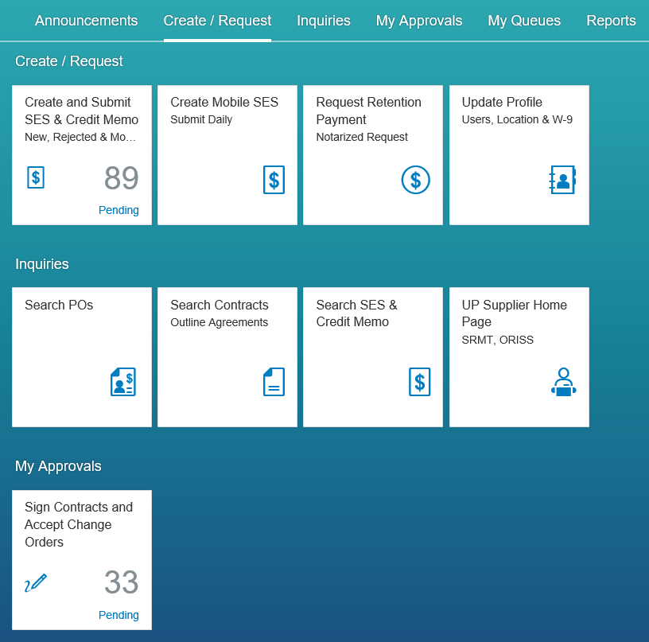
UP SourceHub Launchpad
NOTE: While screen shots may include real names, the data has been modified for purposes of this presentation and is not representative of actual data

Slide 14
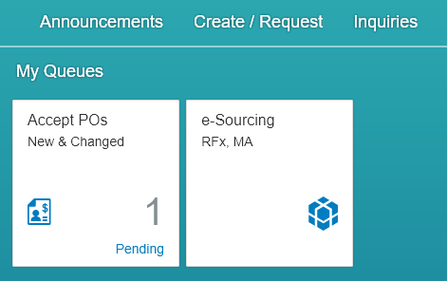
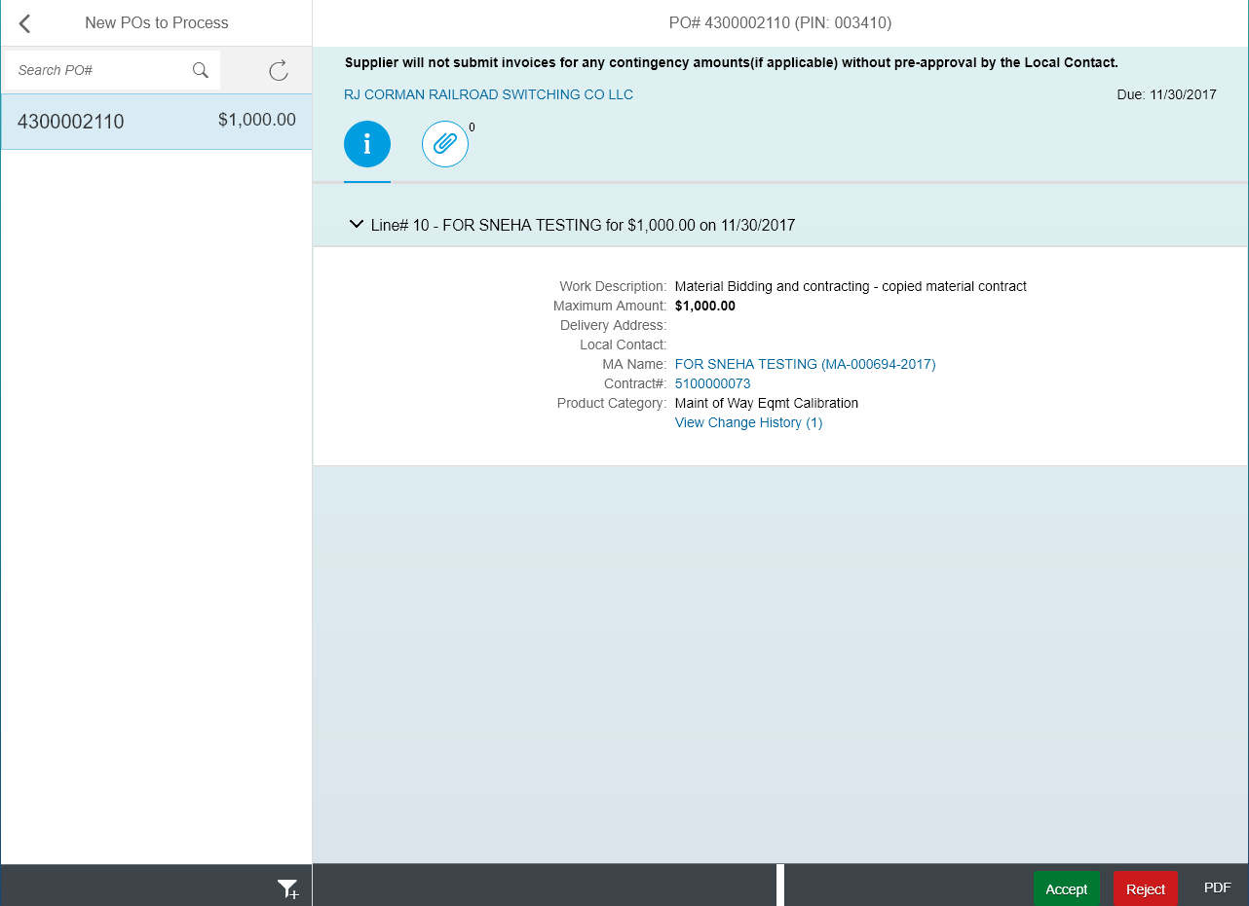
Accepting PO

Slide 15
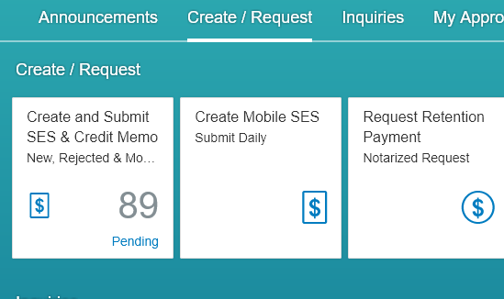
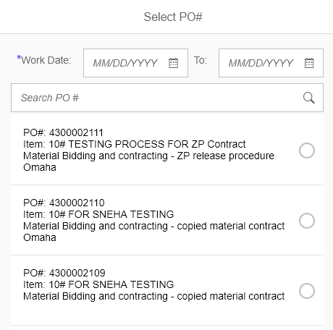
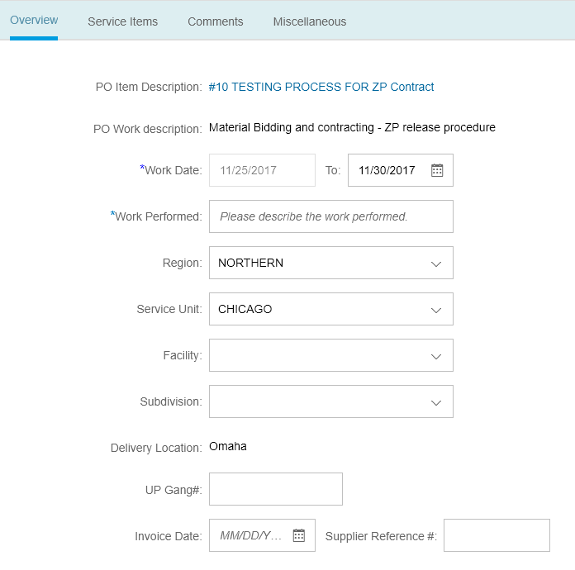
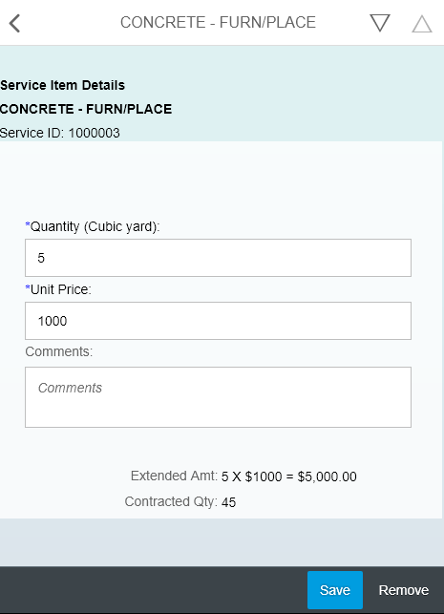
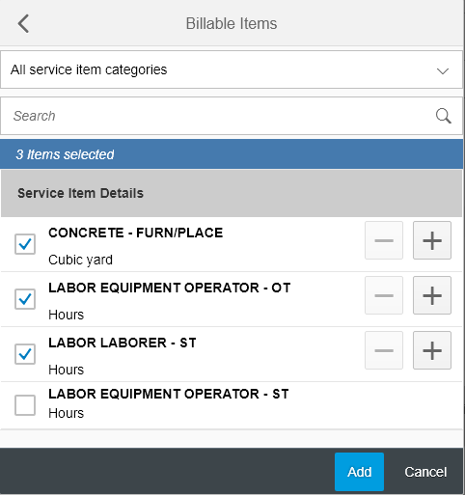
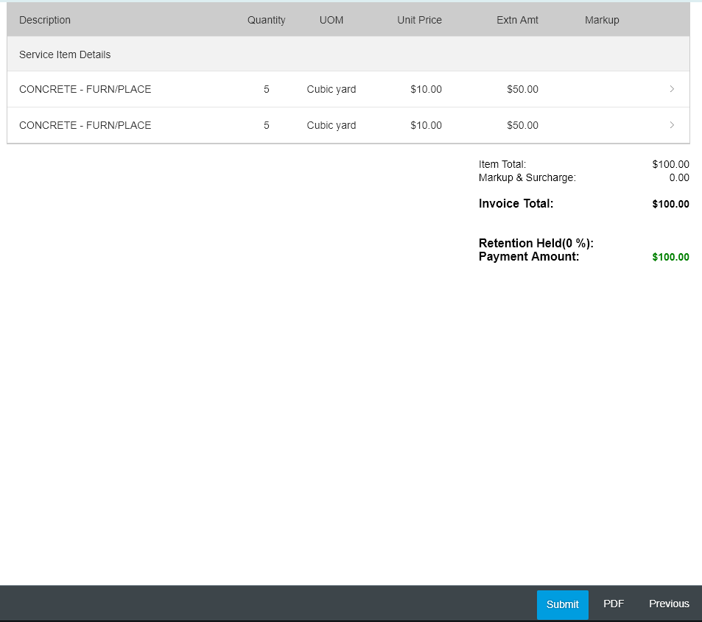
Submitting SES

Slide 16
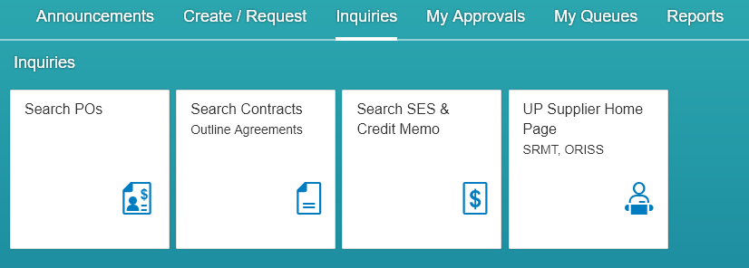
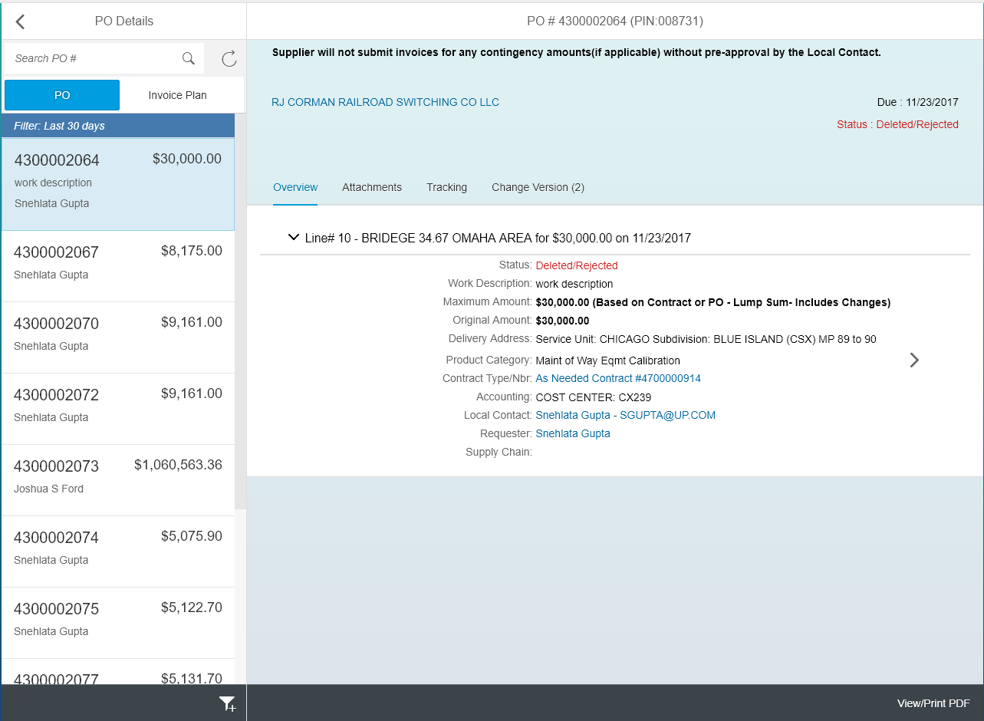
Searching POs, Contracts, SES

Slide 17
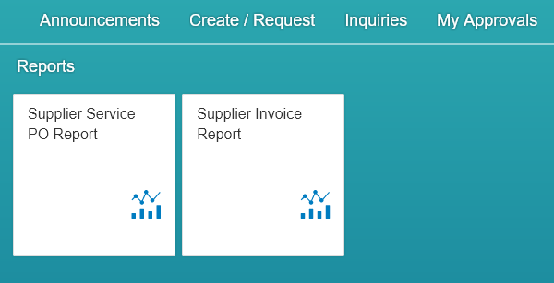
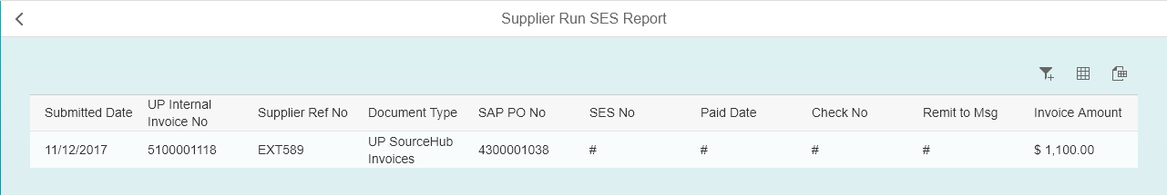
Reporting

