Slide 1

UP SourceHub
Supplier
Webinar
Series
(for non-DWR services)

Slide 2
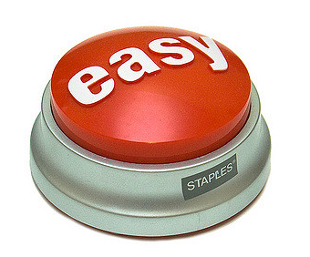
UP SourceHub
Providing a streamlined process from Procure to Pay, with complete visibility along the way
User friendly
100% electronic
Improves efficiency
Drives down cost
Facilitates compliance

Slide 3



Enhanced Procurement Workflow
Provides a streamlined process from request to pay
Requester
Approver
Supplier
Supplier
Releaser
Submits requisition
Approves PO
Accepts PO & Performs Service
Submits SES
for invoicing
Verifies work and Releases SES for payment

Slide 4

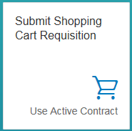
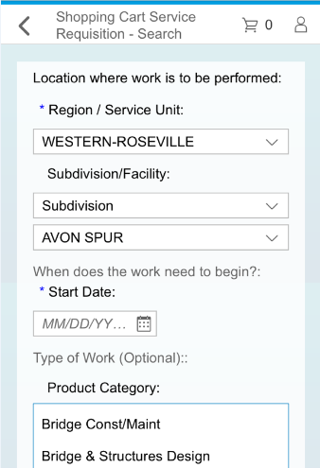
Submit Requisition
UP Requester submits requisition for service using a shopping cart model
Can request a service with existing contract or for new contract
REQUISITION
APPROVAL
PO
WORK/SES
INVC/PMT

Slide 5
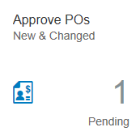

Approve PO
UP Approver reviews and approves requisition/PO electronically and PO issued to supplier
REQUISITION
APPROVAL
PO
WORK/SES
INVC/PMT

Slide 6
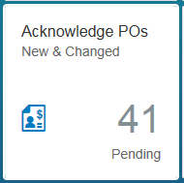

Accept PO
Supplier issued electronic PO with details of requisition to begin work
If PO is accepted, Supplier can begin work.
If PO is rejected, Requester is notified and Supply Chain will coordinate alternate sourcing
Supplier cannot begin work without an accepted PO
REQUISITION
APPROVAL
PO
WORK/SES
INVC/PMT
Notes:
We anticipate most PO’s being accepted by the Suppliers. However, if PO is rejected, notice goes to Requester and PO is routed to Supply Chain for review. Supply Chain will work with the Supplier and Requester to determine why rejected and either modify requirements with existing Supplier or secure an alternate source.

Slide 7
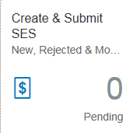

Work Performed/Invoiced
Supplier performs the work as scheduled
Supplier submits Service Entry Sheet (SES) into UP SourceHub with work and billing details
SES will be the supplier’s invoice submission, inclusive of any supporting documentation
REQUISITION
APPROVAL
PO
WORK/SES
INVC/PMT
Notes:
SES becomes Supplier Invoice in UP SourceHub. Supplier will not need to input two different documents.

Slide 8
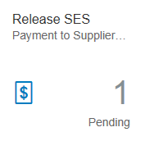

Confirm & Release SES for Payment
SES routed to UP Releaser for confirmation
UP Releaser confirms SES is accurate and releases for payment
REQUISITION
APPROVAL
PO
WORK/SES
INVC/PMT

Slide 9

Other Features & Functionality
Reporting
Bidding and Bid Management
Contracting and Contract Management
eSignatures
Supplier Profile Management

Slide 10

Technical Requirements
Internet Access
Chrome, Internet Explorer or Safari Browser
Microsoft Excel and Microsoft Word (Bidding/Contracting only, Not SES)

Slide 11
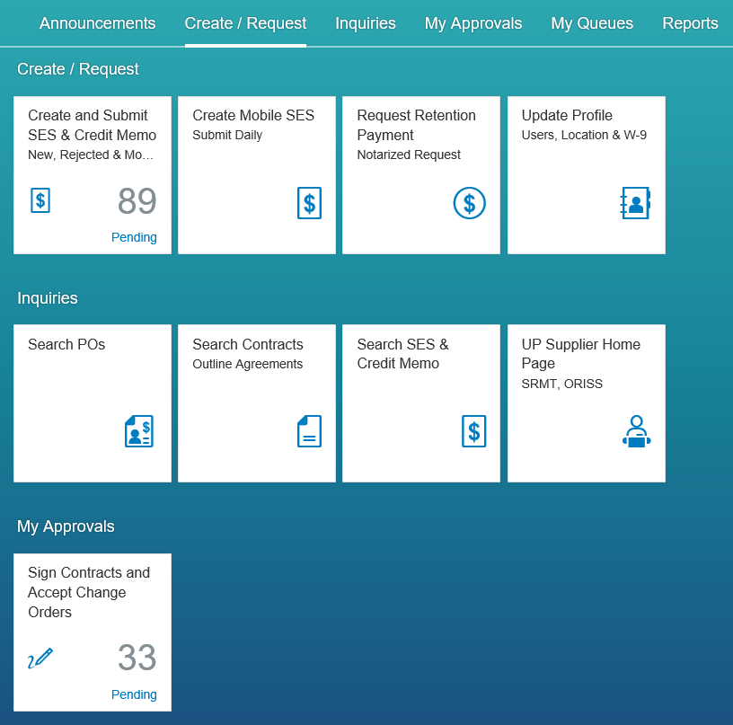
UP SourceHub Launchpad
NOTE: While screen shots may include real names, the data has been modified for purposes of this presentation and is not representative of actual data

Slide 12
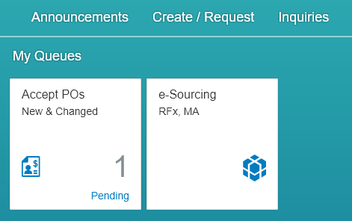
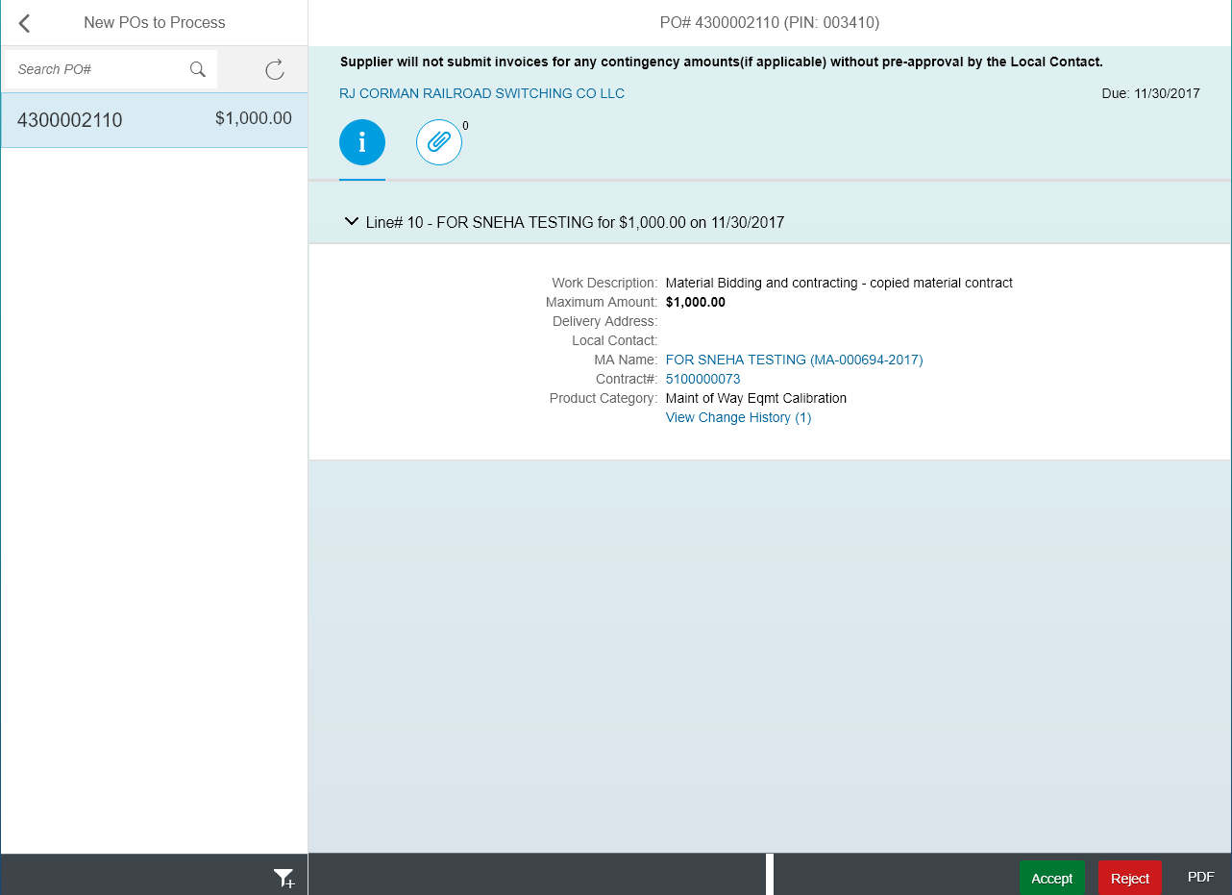
Accepting PO

Slide 13
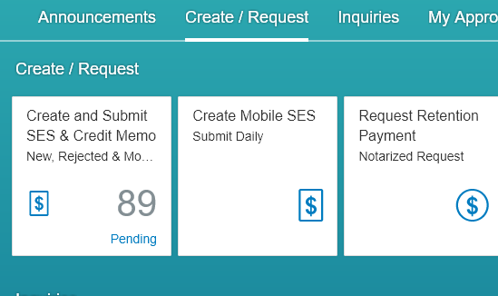
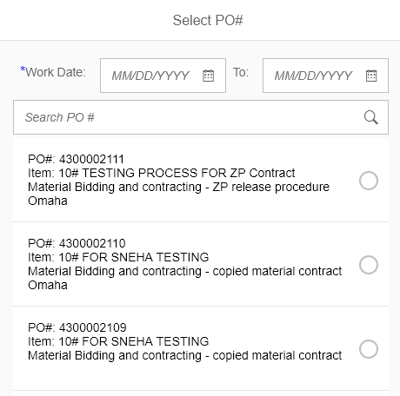
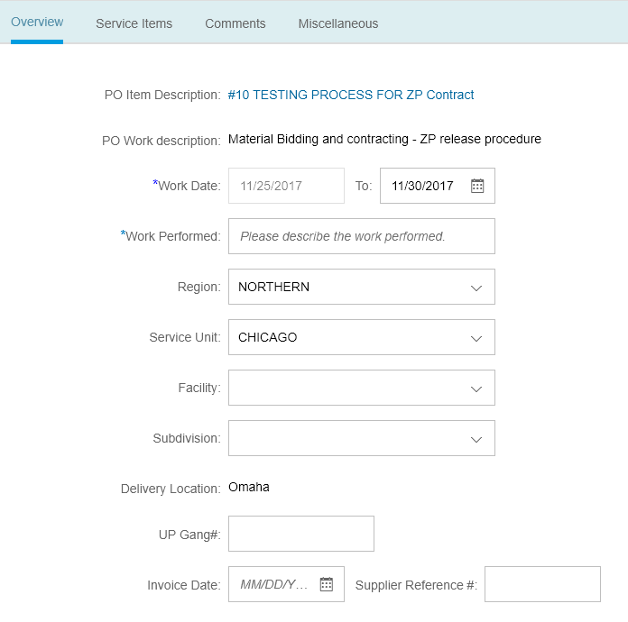
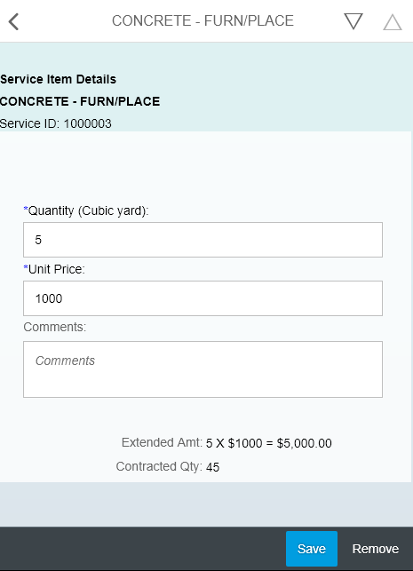
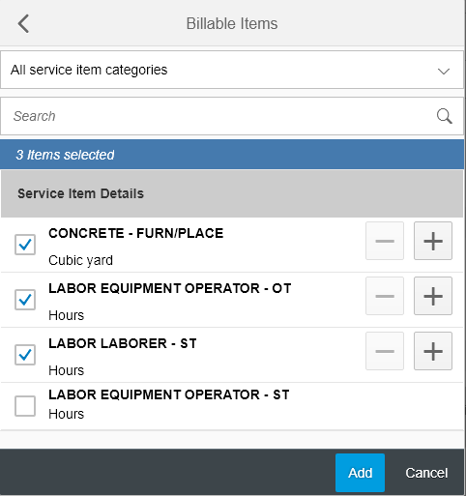
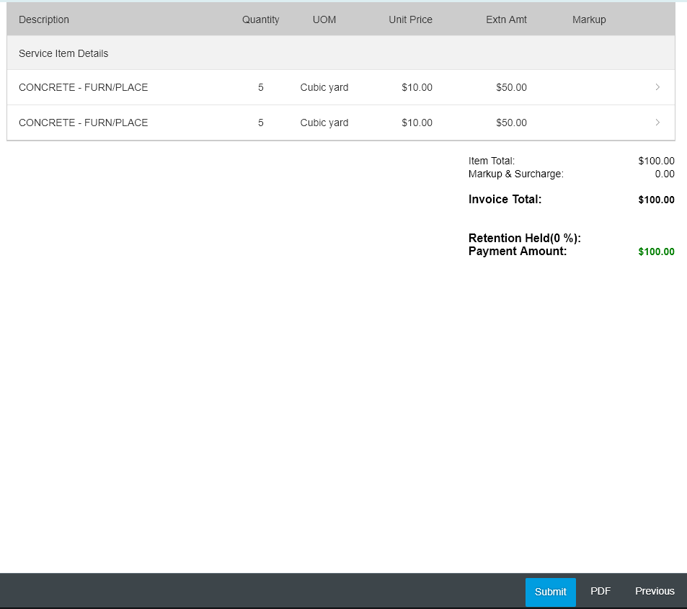
Submitting SES

Slide 14
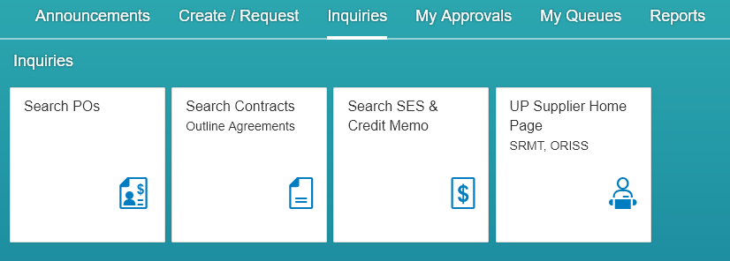
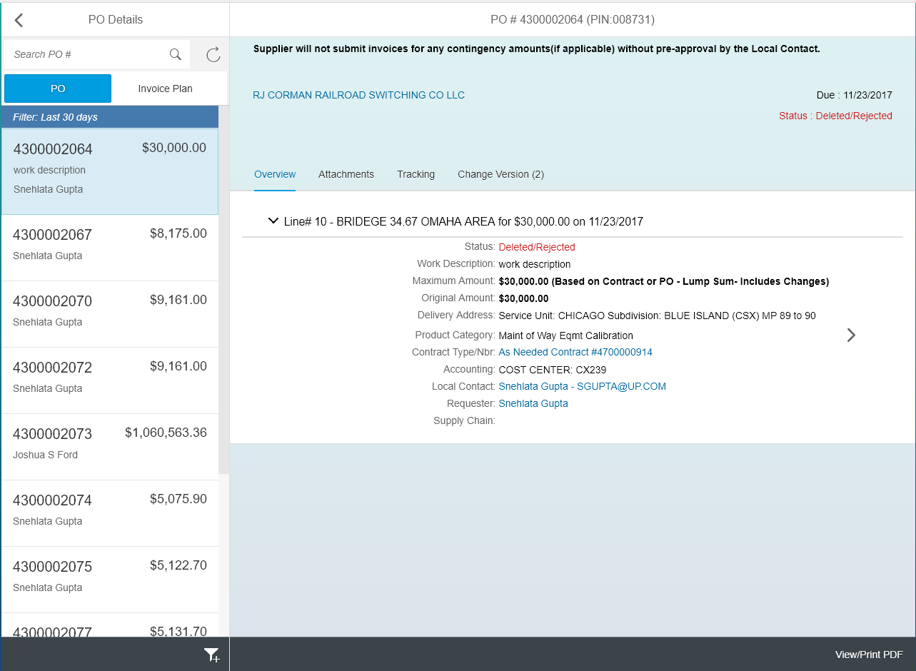
Searching POs, Contracts, SES

Slide 15
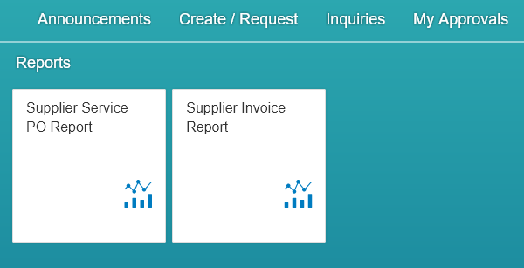
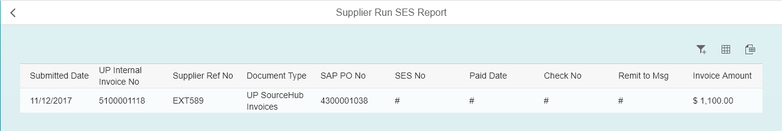
Reporting

