Slide 1
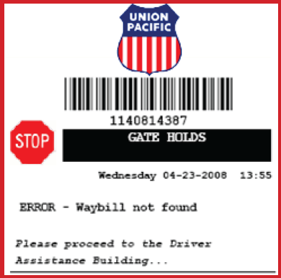
Union Pacific Intermodal Yard AGS (Automated Gate System) Quick Reference for Drivers
Overview:
The AGS system is a self serve automated checkpoint when entering and exiting the Intermodal yard.
Drivers must be registered at the ramp (register at gatehouse) in order to use the system.
Drivers will be required to enter all information using a touchscreen at the driver kiosk.
All bobtail drivers must check in and out.
Ingate:
Make sure the following information is available:
Your driver’s licence number
Unit initial & number (container or chassis or trailer)
Seal number
If picking up – the pickup number for the unit
Press ENTER to begin the process at the kiosk
Follow the prompts on the driver kiosk screen
When transaction complete, your J-1 will print.
Outgate:
Scan the barcode on your J-1 ticket received at ingate.
If you did not provide your pick up information at ingate, you will need to provide the following information
Release number (pickup number)
Driver’s Assistance Booth:
You will be directed to the driver’s assistance area if there
is an issue with your transaction such as:
No billing
Driver not registered
Unit already in inventory (ingate)
Unit not in inventory (outgate)
No seal on load
Improper placards
Example of
an error requiring
gate assistance

